Slide 1
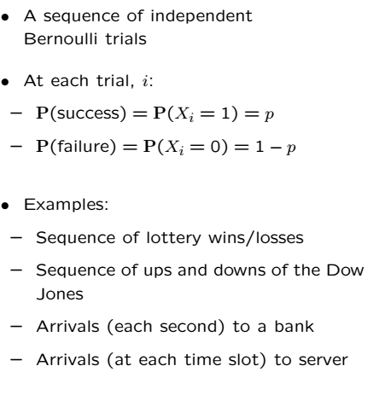
The Bernoulli Process

Slide 2



Why is it Called Bernoulli Process?
The value at each slot is a Bernoulli RV
S is the number of successes in n time slots and is Binomial

Slide 3
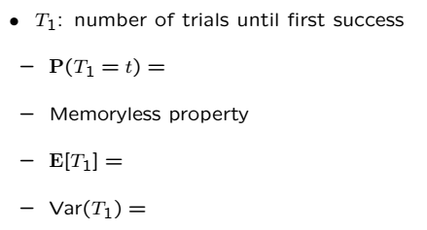
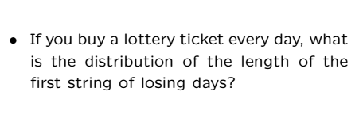
Interarrival Times

Slide 4
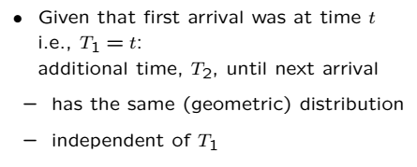
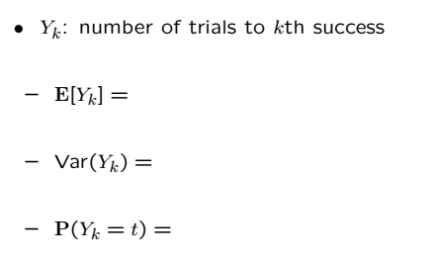
Time of the kth arrival

Slide 5
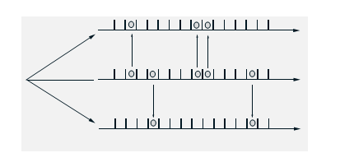
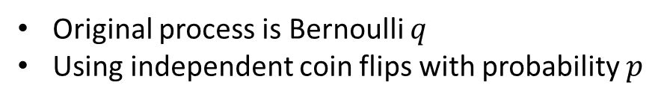
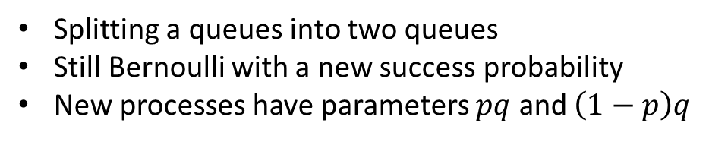
Splitting of a Bernoulli Process
Original process is Bernoulli $q$
Using independent coin flips with probability $p$
Splitting a queues into two queues
Still Bernoulli with a new success probability
New processes have parameters $pq$ and $\left(1−p\right)q$

Slide 6
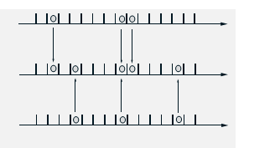
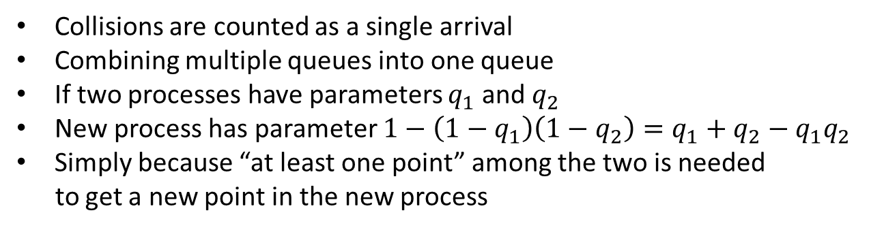
Merging of Independent Bernoulli Processes
Collisions are counted as a single arrival
Combining multiple queues into one queue
If two processes have parameters $q_{1}$ and $q_{2}$
New process has parameter $1−\left(1−q_{1}\right)\left(1−q_{2}\right)=q_{1}+q_{2}−q_{1}q_{2}$
Simply because “at least one point” among the two is needed
to get a new point in the new process

Slide 7
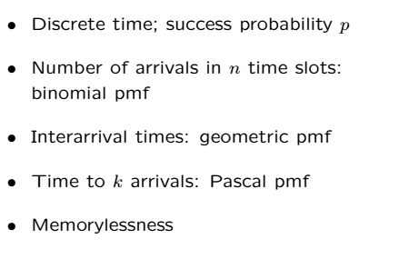
Bernoulli Process Review

Slide 8
Acknowledgements and Citations
Parts of these slides are adapted from the following resources:
Power Point Lecture Slides for the Textbook http://bcs.wiley.com/hebcs/Books?action=index&bcsId=8676&itemId=1118324560
John Tsitsiklis. 6.041 Probabilistic Systems Analysis and Applied Probability, Fall 2010. (Massachusetts Institute of Technology: MIT OpenCourseWare),http://ocw.mit.edu (Accessed 13 Apr, 2015). License: Creative Commons BY-NC-SA

